Slide 1



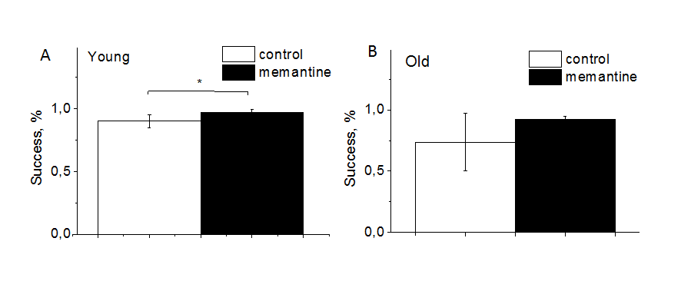
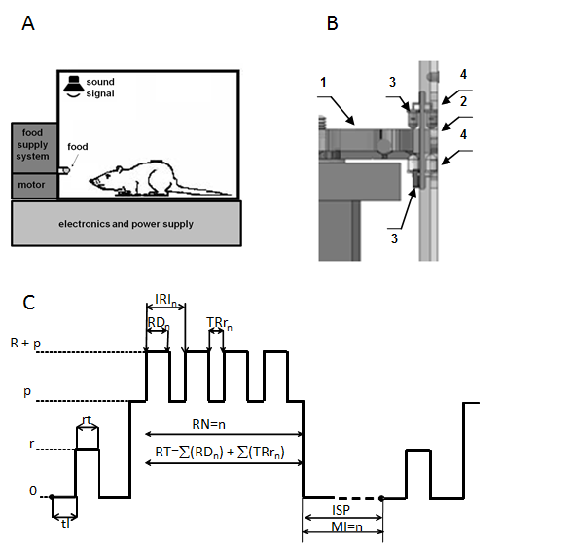
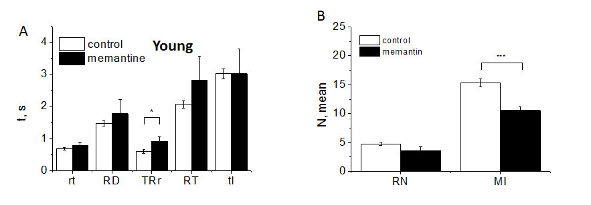
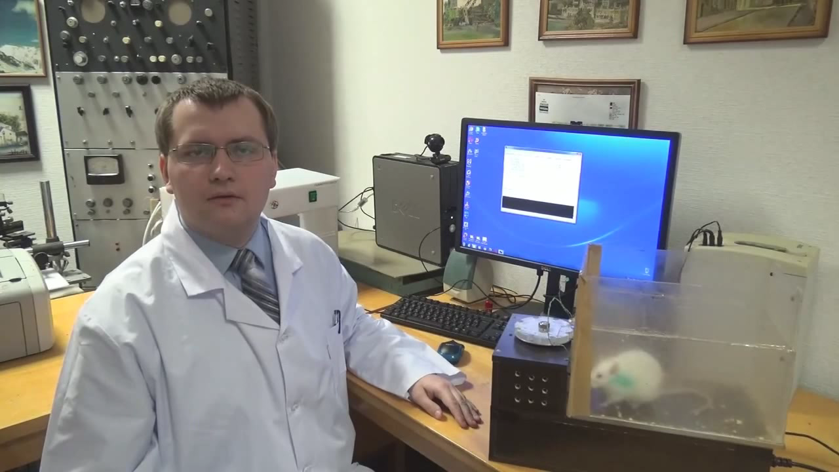
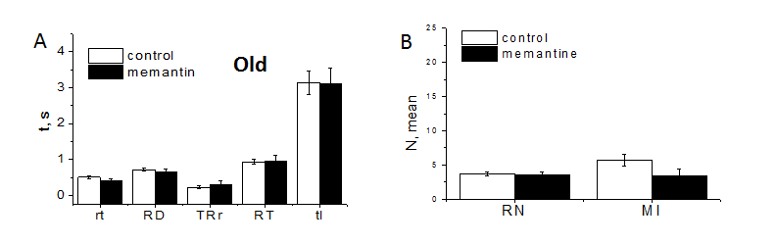
EFFECTS OF MEMANTINE ON TIME PARAMETERS OF BEHAVIOR RESPONSES
IN DIFFERENT AGE GROUPS OF RATS
Gorbachenko V.A., Kruchenko Zh.O., Tyschenko Yu.M., Vrublevsky S.V., Lukyanetz E.A.
Dept. Biophysics of Ion Channels, Bogomoletz Institute of Physiology, Kyiv, Ukraine
ABSTRACT
Alzheimer's disease (AD) is the most common form of dementia. AD causes almost half of the cases of dementia, relating to neurodegenerative diseases. It is characterized by memory loss, weakening of cognitive abilities and serious changes in the dynamics of long-term behavior. There is the notion that AD is accompanied by hippocampus-dependent disorders of learning and memory related to violation of synaptic density, as well as increased levels of beta-amyloid in the neocortex. Memantine (1-amino-3,5-dimethyl-adamantane), which is an NMDA receptor antagonist much used for the treatment of moderate to noticeably expressed AD. In our experiments we used the analysis the effects of memantine on changes in temporal features of motor phenomena of rats in the performance of food operant conditioned reflex of obtaining food from feeder to response on a short beep. Using the device and software developed by us to register the time parameters, the individual components of sensorimotor reactions, the latent period, time of motor response obtaining food, the amount of attempts needed for this and other timing were analysed. Such time indicators characterize the speed of information processing in the central nervous system and the overall level of excitability and motivation of animals. Temporal characteristics of individual units of sensorimotor responses are informative indicators of the functional state of the central nervous system, able to ensure the effectiveness of its monitoring and correction. The aim of our studies was to determine the effect of memantine on these parameters. We found that memantine increased the performance of old rats and slowed down their motor responses. Memantine also increased the productivity of old rats and slowed down their motor responses.
Besides, we tested influence of memantine on emotional-behavioural reactions is the "open field" test. Experimental studies allow to draw the following conclusions: memantine is well tolerated, improves the motivational characteristics of behaviour, significantly increases orientation and research behaviour of rats. It reduces the level of anxiety, fear, uncertainty, which in general can be characterized as an adaptive-stimulating effect. Pharmacological action of memantine is expedient and perspective for further studying.
Keywords: aging, cognitive abilities, food reflex, rat, photoelectric registration, memantine, sensory-motor responses, Alzheimer's disease.
The mean data of registration of successfulness of conditional food reflex
(rat obtaining of feed after sound) measured in control conditions (white) and in rats which consumed memantine (black).
The general block diagram of the experimental setup.
B, infrared sensors for registration of conditioned food reflex: 1 - turntable plate with cells, 2 - window for food delivery, 3 − a pair of sensors for detecting the presence of food in the cell, 4 − pair of sensors for detecting the presence of limb in the cell. C, protocol of experiment for photoelectric registration of conditioned food reflex (designations in the text).
The average values of temporal characteristics of rat food reflex
recorded in the control and under the application of drug memantine in young rats. B, the average values of quantitative characteristics of rat food reflex recorded in the control and under the application of drug memantine. Significance of the differences with P<0,05, <0,01 and <0,001 are indicated by one, two, and three asterisks, respectively.
The device and software developed by us to register the time parameters, the individual components of sensorimotor reactions
The average values of temporal characteristics of rat food reflex
recorded in the control and under the application of drug memantine in old rats. B, the average values of quantitative characteristics of rat food reflex recorded in the control and under the application of drug memantine. Significance of the differences with P<0,05, <0,01 and <0,001 are indicated by one, two, and three asterisks, respectively.
Copyright © 2018 BIPH
Notes:
Please export the PowerPoint document as a PDF) and upload the PDF into the system. Do not use a font size smaller than 16.

